Slide 1

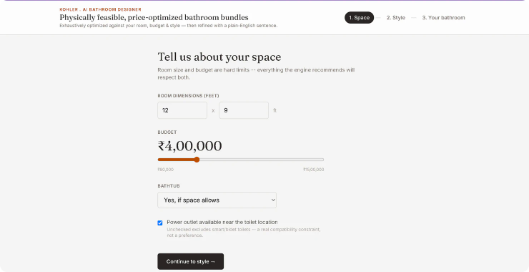


KOHLER · PHASE 2 CASE STUDY
From Bathroom Requirements to a Complete 3D Design
Planning a bathroom means balancing room dimensions, budget, product compatibility, aesthetics, and functional needs — all at once.
The KOHLER AI Bathroom Designer & Planner is an interactive assistant that guides you from your inputs — room dimensions, budget, design style and constraints — through a recommendation engine to an optimized product bundle and a fully interactive 3D bathroom with natural-language refinement.
ROOM DIMENSIONS
BUDGET
12 × 9 ft
₹4,00,000
BATHTUB
POWER OUTLET
Yes, if space allows
Available near toilet
REQUIREMENTS → RECOMMENDATION ENGINE → OPTIMIZED BUNDLE → INTERACTIVE 3D → NL REFINEMENT
THE STARTING POINT — YOUR SPACE, BUDGET & CONSTRAINTS
01 / 04

Slide 2


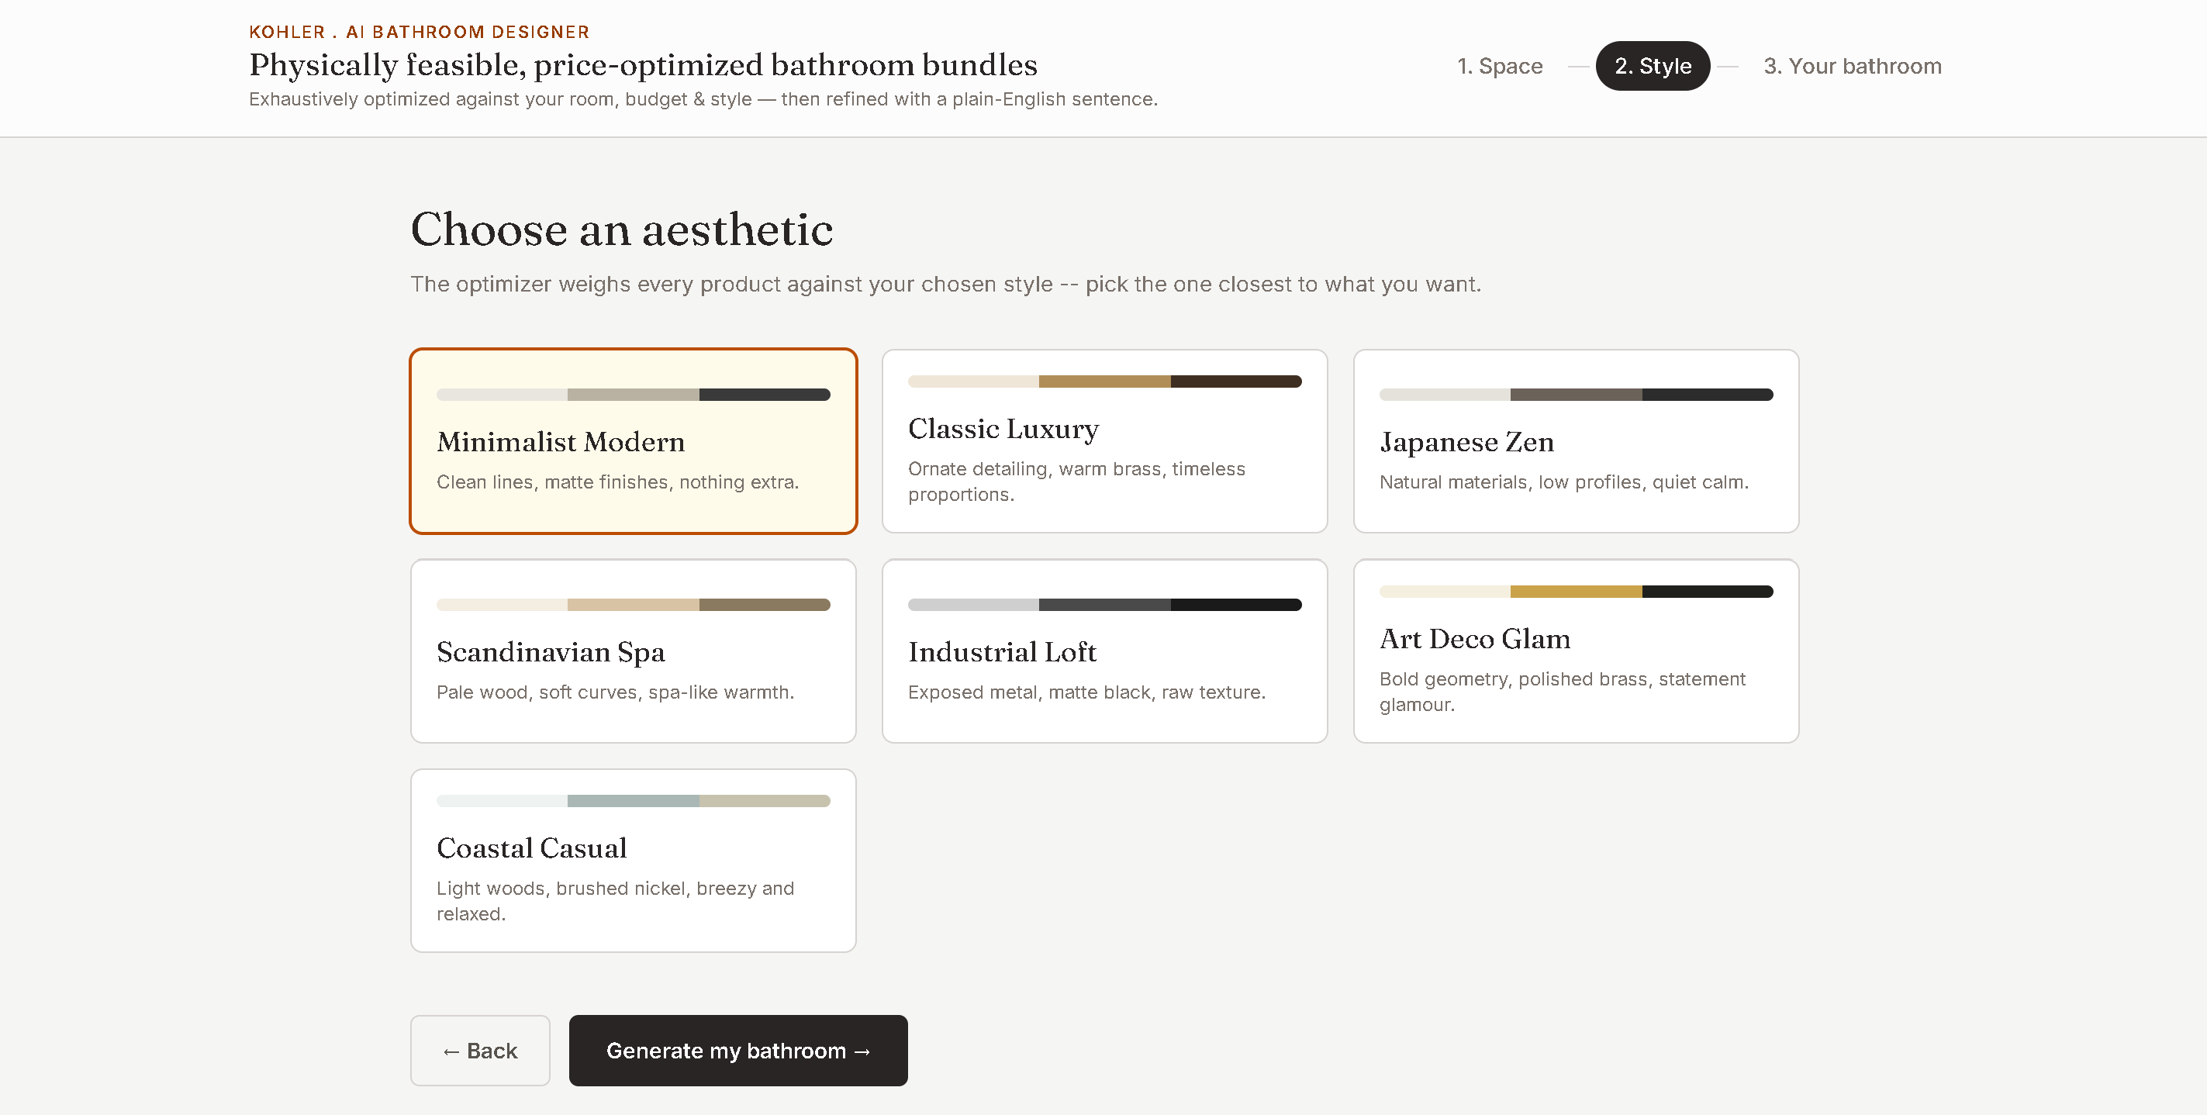




Constraint-Aware Recommendation Engine
INPUTS
30-PRODUCT STRUCTURED CATALOG
Space — room width + depth
Budget — user-defined INR limit
Style — Minimalist Modern, Classic Luxury, Japanese Zen, Scandinavian Spa, Industrial Loft, Art Deco Glam, Coastal Casual
Constraints — bathtub requirement, power availability
Categories: Toilets · Showers / Bathtubs · Vanities · Faucets
Each product carries price, dimensions, quality, theme compatibility and functional compatibility attributes.
OPTIMIZATION — EXHAUSTIVE COMBINATION SEARCH
Final Score = Quality + Theme Fit + Value − Budget Penalty − Space Penalty
Budget and space act as scoring constraints — penalized, never ignored.
VALUE
BALANCED
LUXURY
Cost-conscious bundle that maximizes value while staying well within budget.
Balanced profile weighing quality and cost for the strongest all-round design.
Premium quality focus, prioritizing top-tier products for a high-end result.

Slide 3
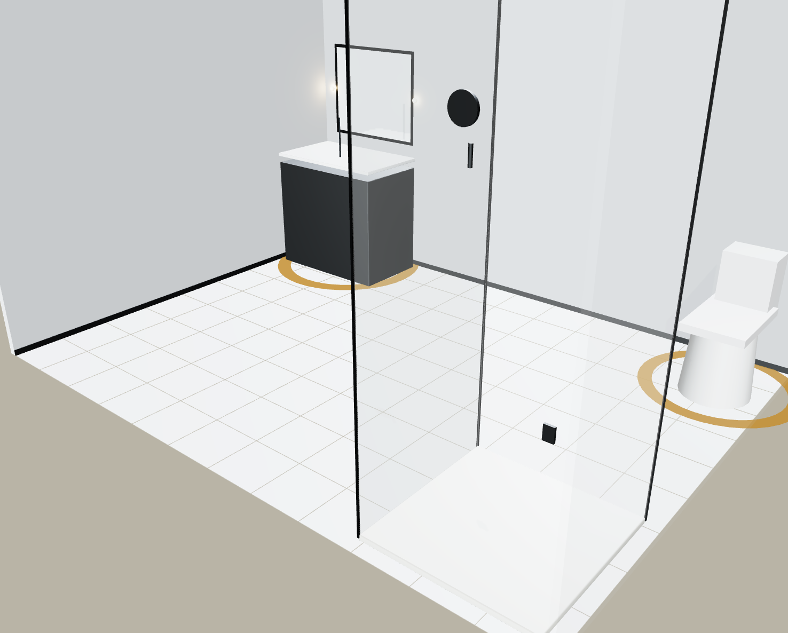


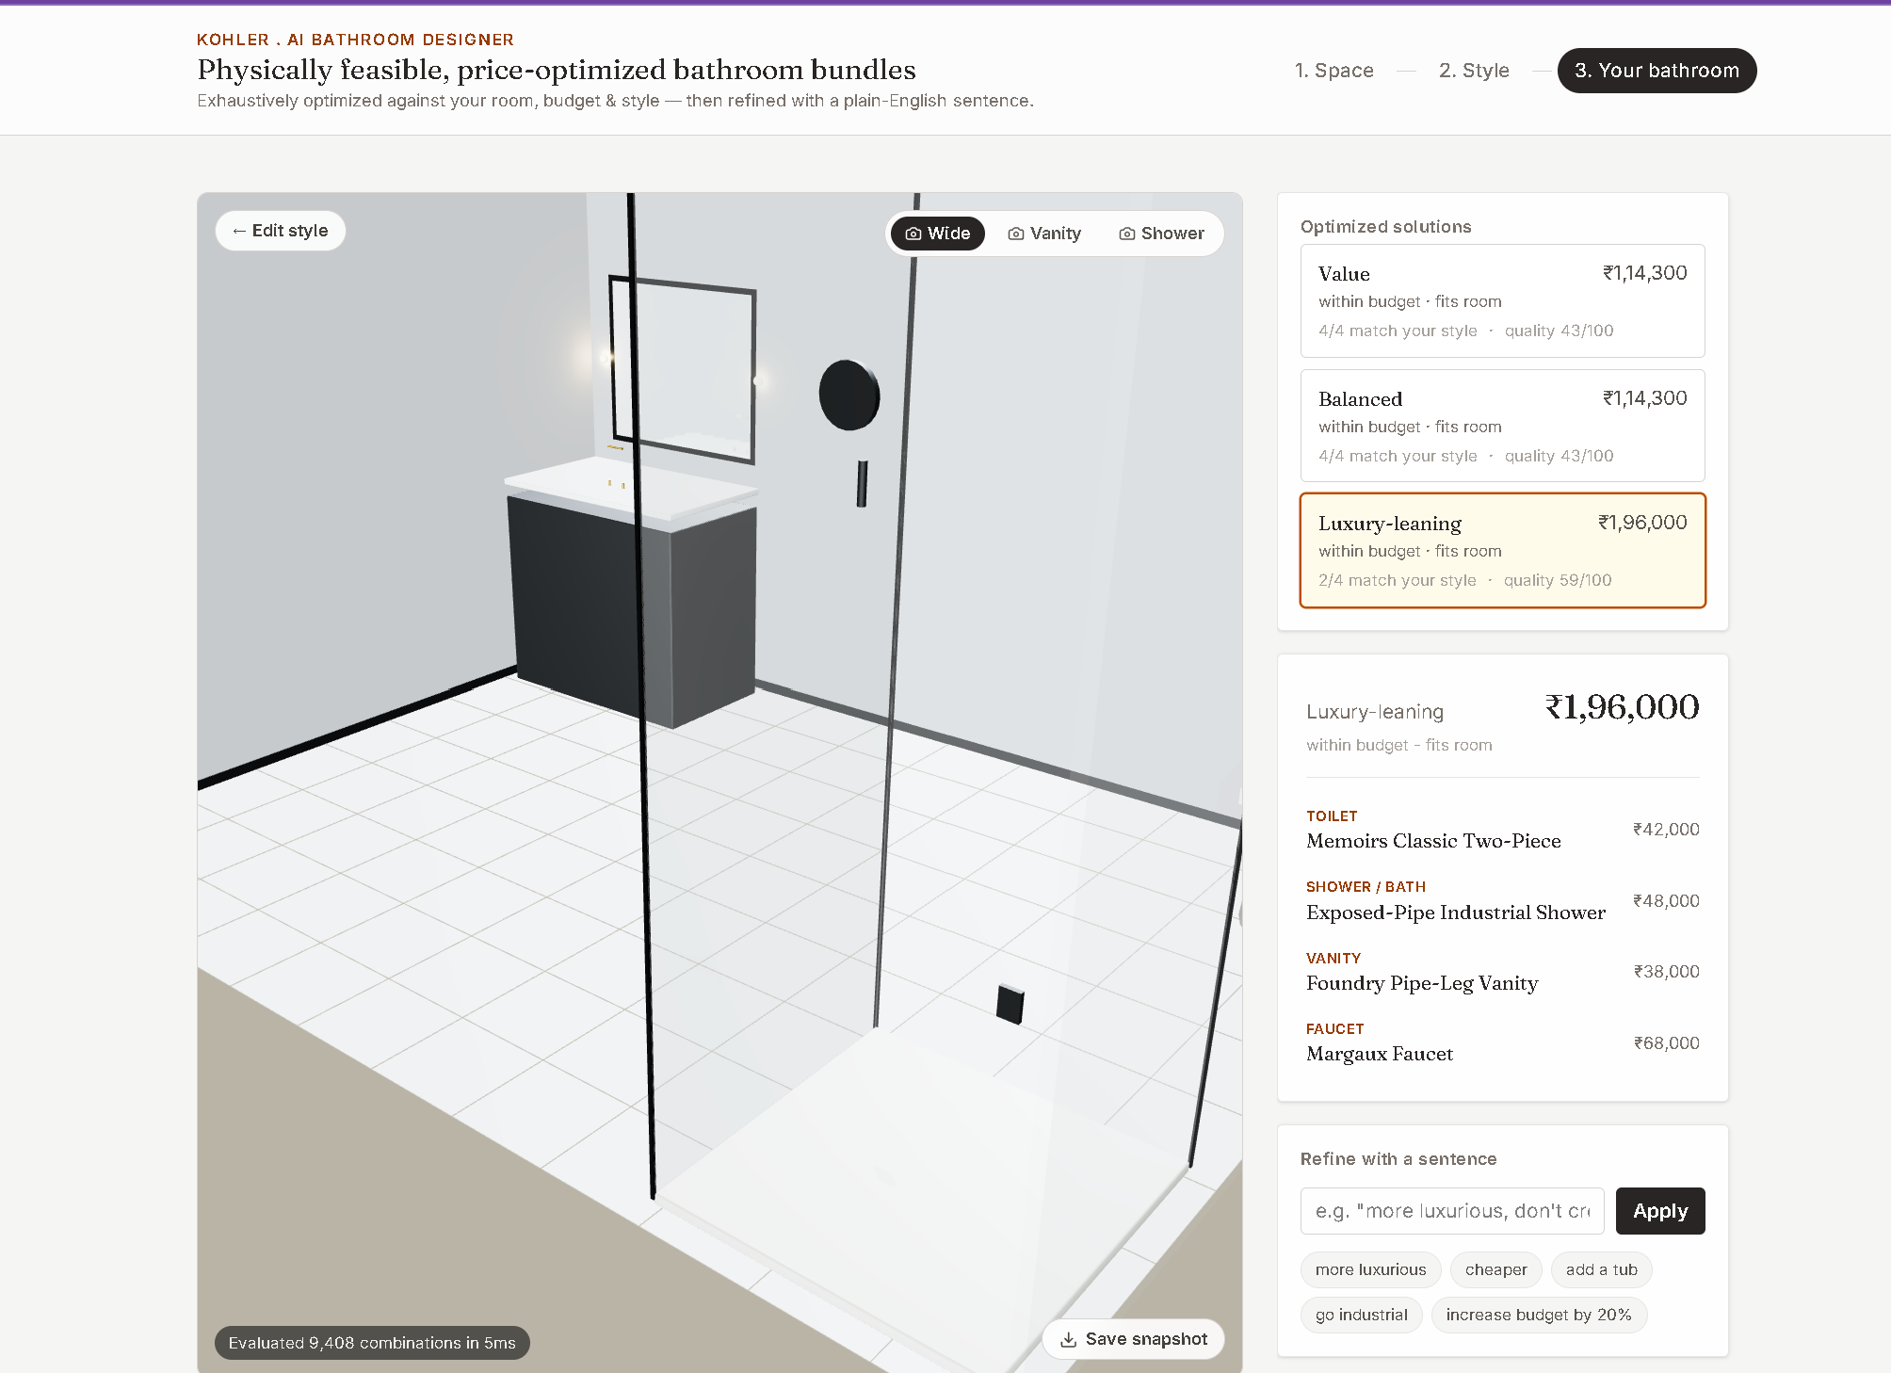
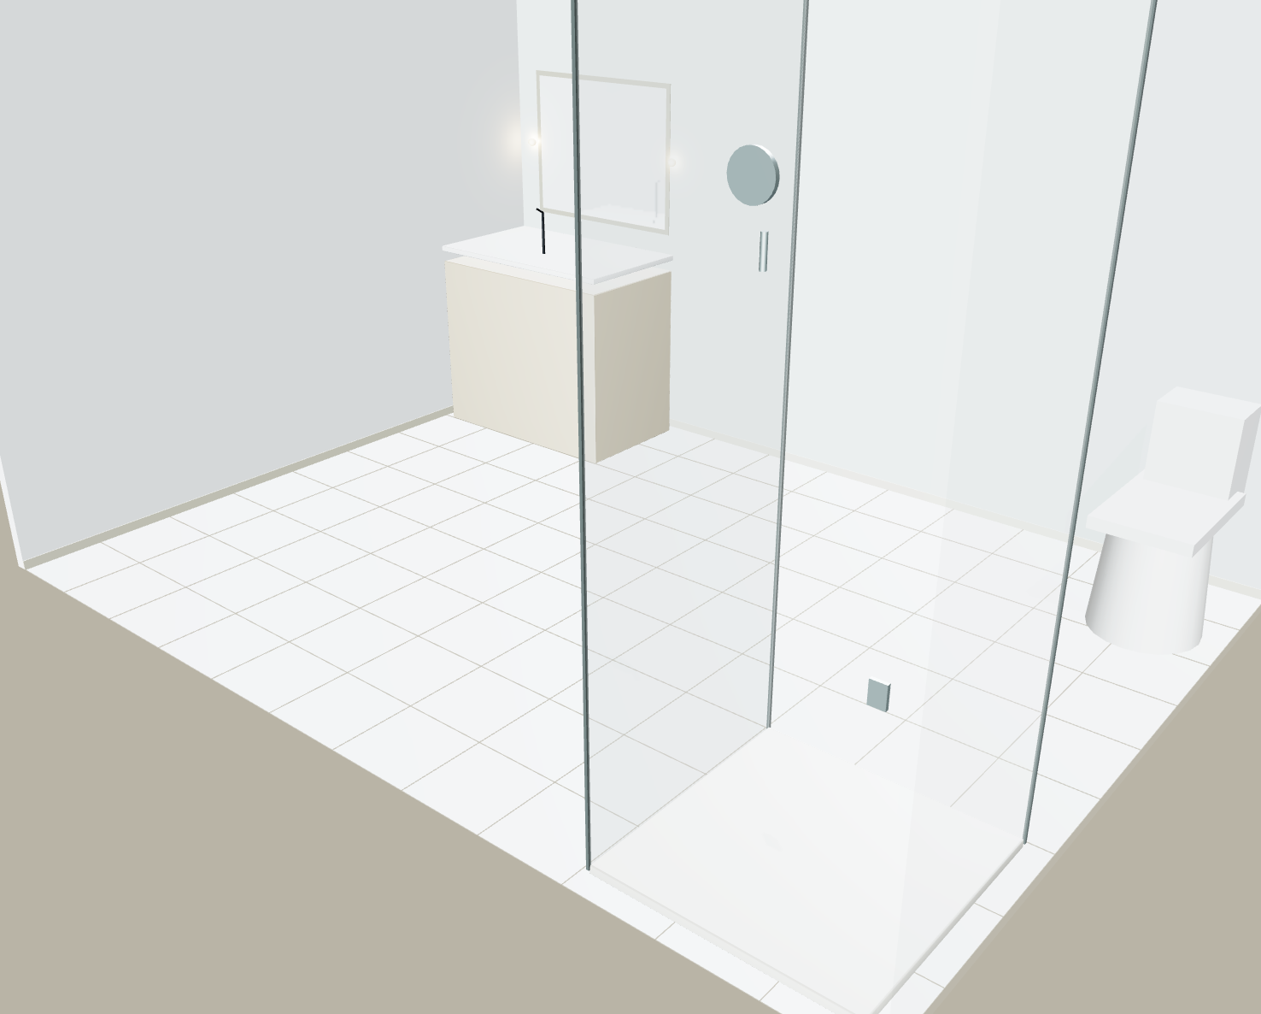
THE INTERACTIVE 3D EXPERIENCE
Design, Visualize & Refine
3D VISUALIZATION · REACT THREE FIBER + THREE.JS
Cameras — Orbit, Wide, Vanity, Shower
Elements — toilet, vanity, faucet, shower/bathtub, mirror, lighting
Theme-dependent room appearance
Snapshot export
NATURAL-LANGUAGE REFINEMENT
“Make it more luxurious” “Add a tub” “Go industrial” “Increase budget by 20%” “Don't cross ₹2L”
Natural Language → Intent Extraction → Updated Constraints → Re-run Optimizer → Updated 3D Design
Rule-based · fast · deterministic · explainable · no external API
INPUT → RECOMMENDATION → 3D DESIGN → REFINEMENT

Slide 4



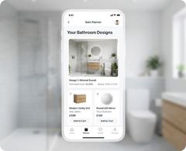
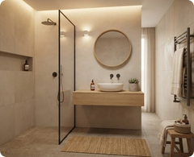
From Prototype to a Scalable Bathroom Design Platform
WHAT THE PROTOTYPE DELIVERS
TECHNOLOGY STACK
FUTURE SCOPE
30-product structured catalog
7 design themes
3 optimized solution profiles
Interactive 3D visualization
Natural-language refinement
Budget & space-aware recommendations
Explainable optimization
Snapshot export
React + Vite
↓
Zustand State
↓
Optimization Engine
↓
React Three Fiber + Three.js
↓
Interactive 3D Experience
Real KOHLER product catalog & live data
Real SKUs and specifications
Advanced spatial & collision detection
Plumbing-aware layouts
Image & floor-plan understanding
LLM-powered design assistant
Advanced AI conversation
Photorealistic & AR / immersive visualization
Also: JavaScript · Tailwind CSS · Lucide React
A constraint-aware design assistant that turns bathroom requirements into personalized, visual and actionable product solutions.

